Slide 1



Reinforcement Learning and Autonomous Systems (AI 4102)
Lecture 2 (18/08/2023)
Lecture 3 (21/08/2023)
Instructor: Gourav Saha

Slide 2
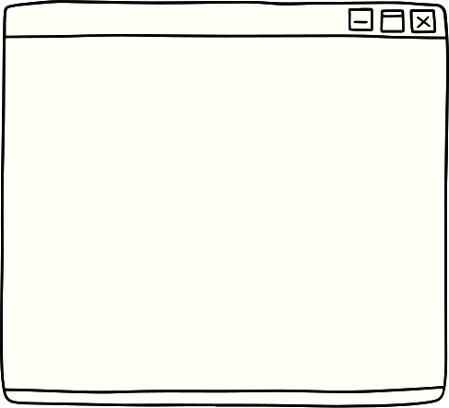
Lecture Content
Stochastic process (very brief introduction; only that what is required for this course).
Markov Decision Process and Reinforcement Learning.
Special Cases of Markov Decision Process.
Stationary vs Non-Stationary Process.
Objective functions in Reinforcement Learning.
Reinforcement Learning vs ….

Slide 3
Lecture Content
Stochastic process (very brief introduction; only that what is required for this course).
Visualizing stochastic process using Probabilistic Graphical Model.
Markov process.
Markov Decision Process and Reinforcement Learning.
Special Cases of Markov Decision Process.
Stationary vs Non-Stationary Process.
Objective functions in Reinforcement Learning.
Reinforcement Learning vs ….

Slide 4

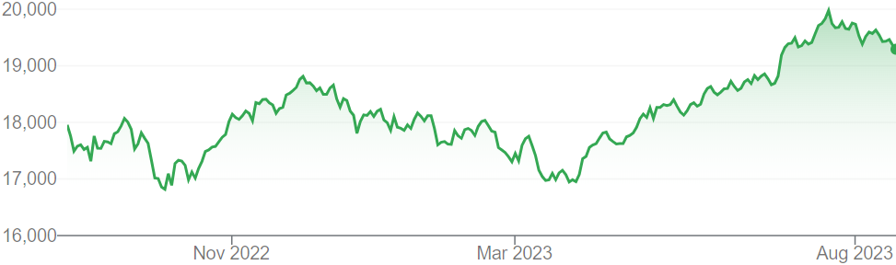
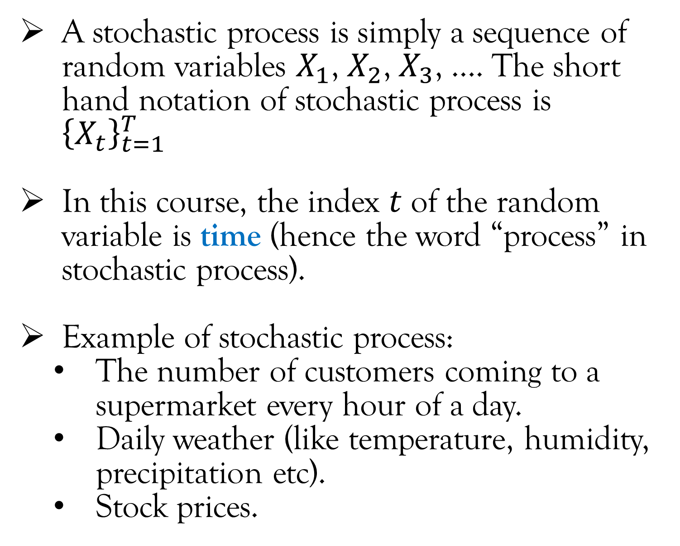
Stochastic Process
A stochastic process is simply a sequence of random variables $X_{1}$, $X_{2}$, $X_{3}$, …. The short hand notation of stochastic process is ${\left\{X_{t}\right\}}_{t=1}^{T}$
In this course, the index $t$ of the random variable is time (hence the word “process” in stochastic process).
Example of stochastic process:
The number of customers coming to a supermarket every hour of a day.
Daily weather (like temperature, humidity, precipitation etc).
Stock prices.
NIFTY 50 price
Time

Slide 5
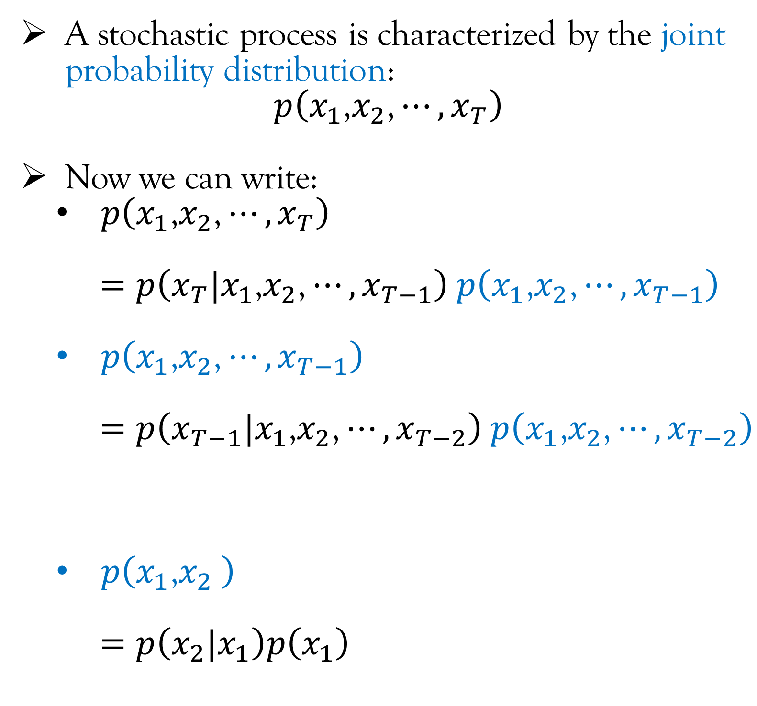
Stochastic Process
A stochastic process is characterized by the joint probability distribution:
$$p\left(x_{1}\text{,}x_{2}\text{,}⋯,x_{T}\right)$$
Now we can write:
$p\left(x_{1}\text{,}x_{2}\text{,}⋯,x_{T}\right)$
$=p\left(x_{T}|x_{1}\text{,}x_{2}\text{,}⋯,x_{T−1}\right)$ $p\left(x_{1}\text{,}x_{2}\text{,}⋯,x_{T−1}\right)$
$p\left(x_{1}\text{,}x_{2}\text{,}⋯,x_{T−1}\right)$
$=p\left(x_{T−1}|x_{1}\text{,}x_{2}\text{,}⋯,x_{T−2}\right)$ $p\left(x_{1}\text{,}x_{2}\text{,}⋯,x_{T−2}\right)$
$p\left(x_{1}\text{,}x_{2} \right)$
$=p\left(x_{2}|x_{1}\right)p\left(x_{1}\right)$

Slide 6
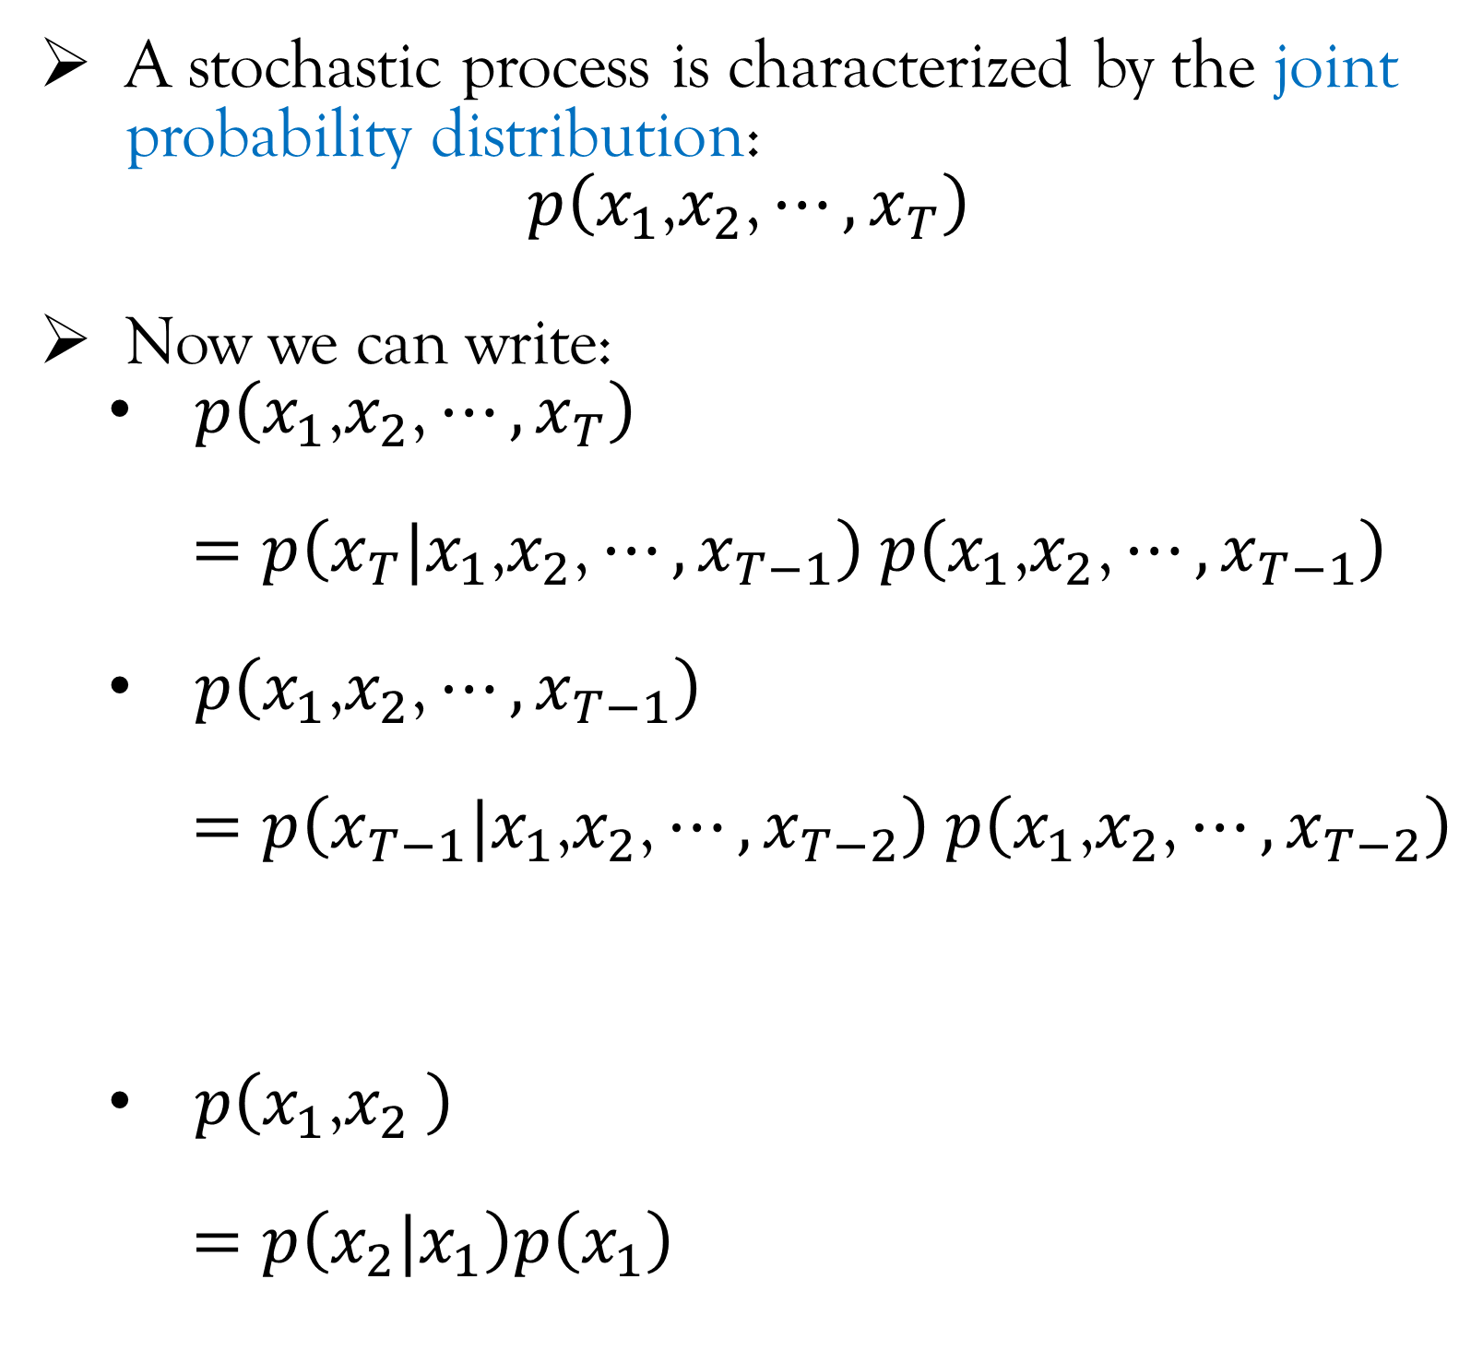
Stochastic Process
A stochastic process is characterized by the joint probability distribution:
$$p\left(x_{1}\text{,}x_{2}\text{,}⋯,x_{T}\right)$$
Now we can write:
$p\left(x_{1}\text{,}x_{2}\text{,}⋯,x_{T}\right)$
$=p\left(x_{T}|x_{1}\text{,}x_{2}\text{,}⋯,x_{T−1}\right)$ $p\left(x_{1}\text{,}x_{2}\text{,}⋯,x_{T−1}\right)$
$p\left(x_{1}\text{,}x_{2}\text{,}⋯,x_{T−1}\right)$
$=p\left(x_{T−1}|x_{1}\text{,}x_{2}\text{,}⋯,x_{T−2}\right)$ $p\left(x_{1}\text{,}x_{2}\text{,}⋯,x_{T−2}\right)$
$p\left(x_{1}\text{,}x_{2} \right)$
$=p\left(x_{2}|x_{1}\right)p\left(x_{1}\right)$
Probabilistic Graphical Model (PGM)
PGMs are graphical representation of the conditional distribution function.
The arrows in the PGM represents the conditional distribution.

Slide 7
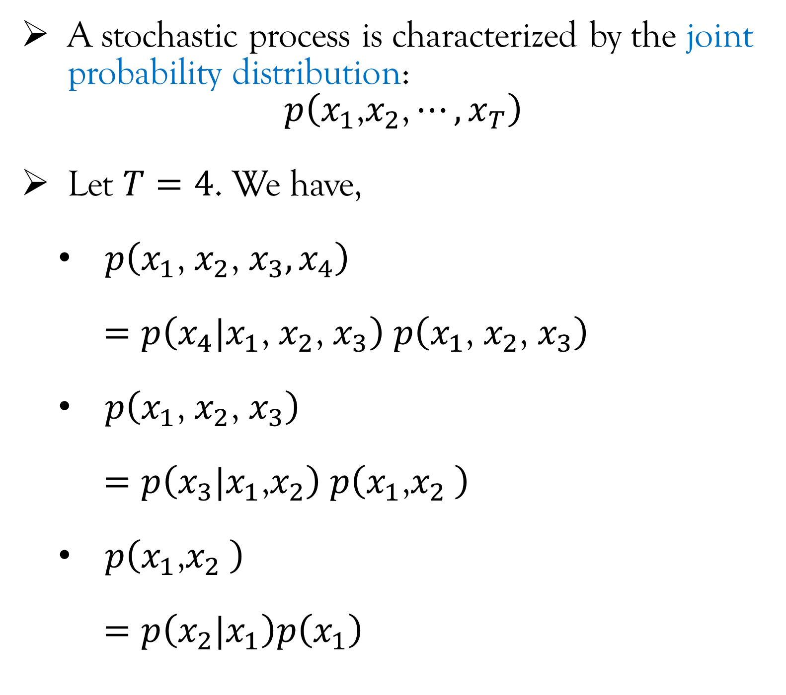
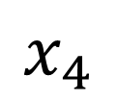
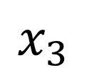
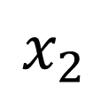
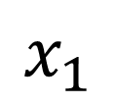
Stochastic Process
A stochastic process is characterized by the joint probability distribution:
$$p\left(x_{1}\text{,}x_{2}\text{,}⋯,x_{T}\right)$$
Let $T=4$. We have,
$p\left(x_{1}\text{,} x_{2}\text{,} x_{3}, x_{4}\right)$
$=p\left(x_{4}|x_{1}\text{, }x_{2}\text{, }x_{3}\right)$ $p\left(x_{1}\text{, }x_{2}\text{, }x_{3}\right)$
$p\left(x_{1}\text{, }x_{2}\text{, }x_{3}\right)$
$=p\left(x_{3}|x_{1}\text{,}x_{2}\right)$ $p\left(x_{1}\text{,}x_{2} \right)$
$p\left(x_{1}\text{,}x_{2} \right)$
$=p\left(x_{2}|x_{1}\right)p\left(x_{1}\right)$
Probabilistic Graphical Model (PGM)
PGMs are graphical representation of the conditional distribution function.
The arrows in the PGM represents the conditional distribution.
$$x_{1}$$
$$x_{2}$$
$$x_{3}$$
$$x_{4}$$

Slide 8
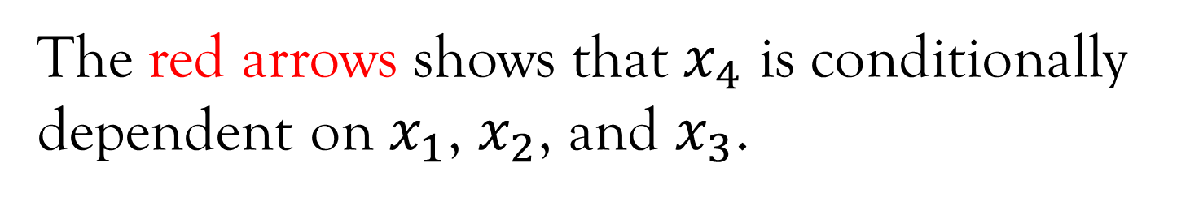
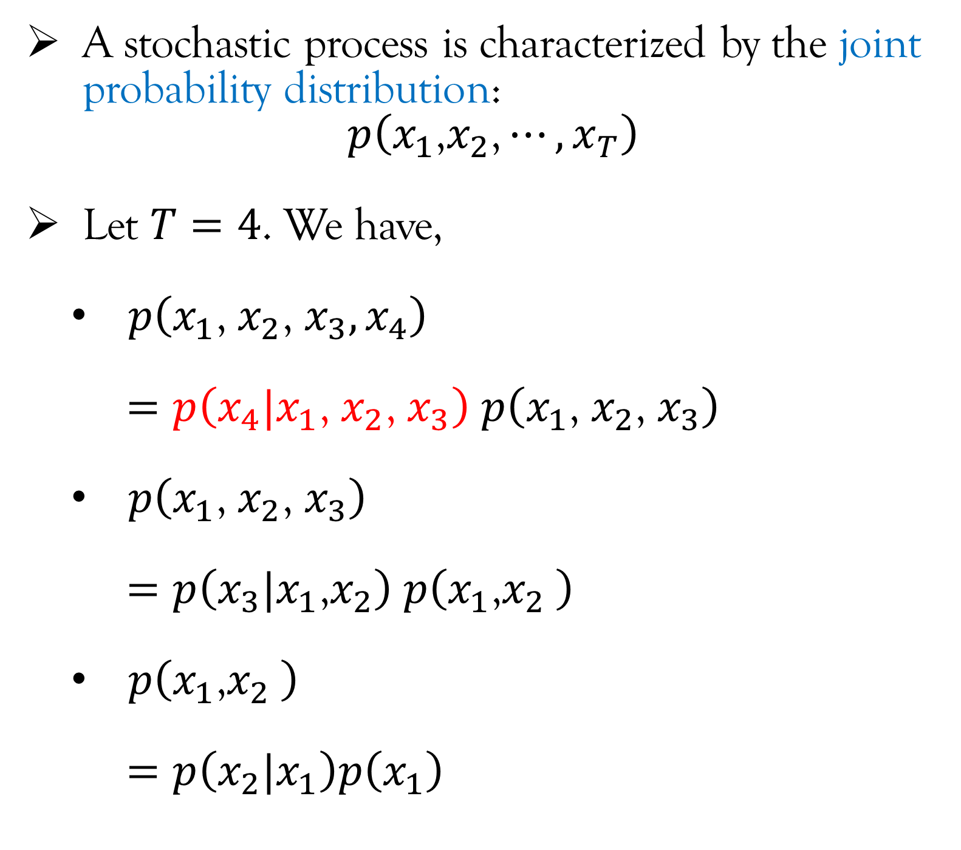
Stochastic Process
A stochastic process is characterized by the joint probability distribution:
$$p\left(x_{1}\text{,}x_{2}\text{,}⋯,x_{T}\right)$$
Let $T=4$. We have,
$p\left(x_{1}\text{,} x_{2}\text{,} x_{3}, x_{4}\right)$
$=p\left(x_{4}|x_{1}\text{, }x_{2}\text{, }x_{3}\right)$ $p\left(x_{1}\text{, }x_{2}\text{, }x_{3}\right)$
$p\left(x_{1}\text{, }x_{2}\text{, }x_{3}\right)$
$=p\left(x_{3}|x_{1}\text{,}x_{2}\right)$ $p\left(x_{1}\text{,}x_{2} \right)$
$p\left(x_{1}\text{,}x_{2} \right)$
$=p\left(x_{2}|x_{1}\right)p\left(x_{1}\right)$
Probabilistic Graphical Model (PGM)
PGMs are graphical representation of the conditional distribution function.
The arrows in the PGM represents the conditional distribution.
$$x_{1}$$
$$x_{2}$$
$$x_{3}$$
$$x_{4}$$
The red arrows shows that $x_{4}$ is conditionally dependent on $x_{1}$, $x_{2}$, and $x_{3}$.

Slide 9
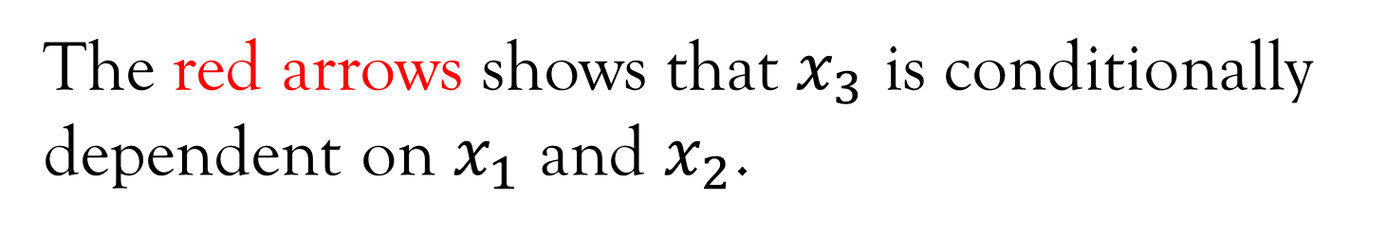
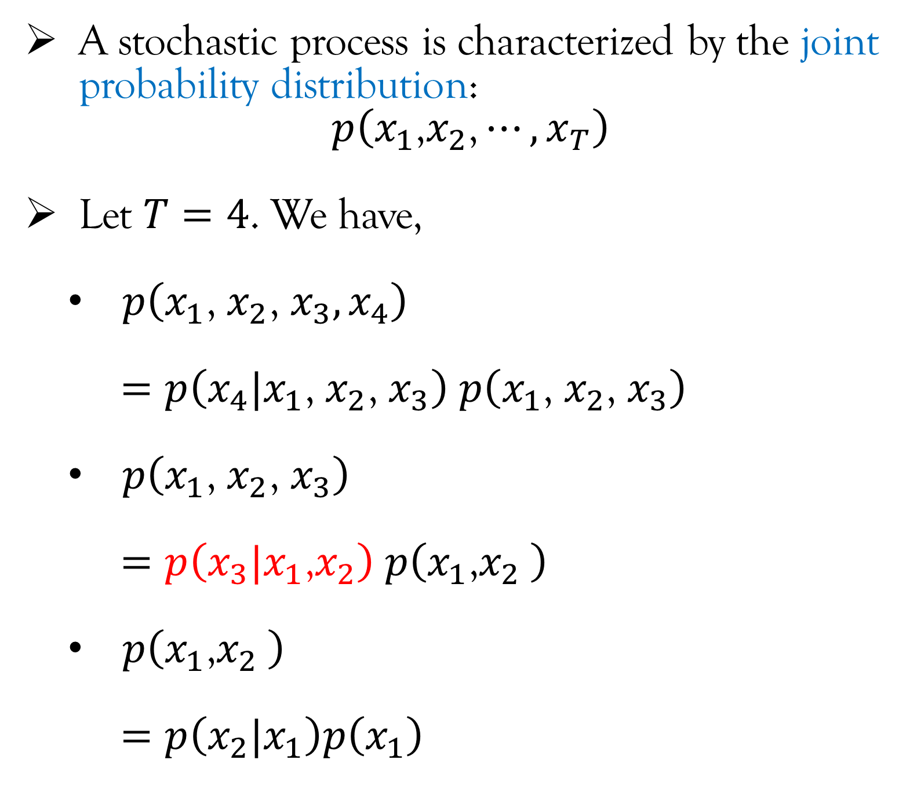
Stochastic Process
A stochastic process is characterized by the joint probability distribution:
$$p\left(x_{1}\text{,}x_{2}\text{,}⋯,x_{T}\right)$$
Let $T=4$. We have,
$p\left(x_{1}\text{,} x_{2}\text{,} x_{3}, x_{4}\right)$
$=p\left(x_{4}|x_{1}\text{, }x_{2}\text{, }x_{3}\right)$ $p\left(x_{1}\text{, }x_{2}\text{, }x_{3}\right)$
$p\left(x_{1}\text{, }x_{2}\text{, }x_{3}\right)$
$=p\left(x_{3}|x_{1}\text{,}x_{2}\right)$ $p\left(x_{1}\text{,}x_{2} \right)$
$p\left(x_{1}\text{,}x_{2} \right)$
$=p\left(x_{2}|x_{1}\right)p\left(x_{1}\right)$
Probabilistic Graphical Model (PGM)
PGMs are graphical representation of the conditional distribution function.
The arrows in the PGM represents the conditional distribution.
$$x_{1}$$
$$x_{2}$$
$$x_{3}$$
$$x_{4}$$
The red arrows shows that $x_{3}$ is conditionally dependent on $x_{1}$ and $x_{2}$.

Slide 10
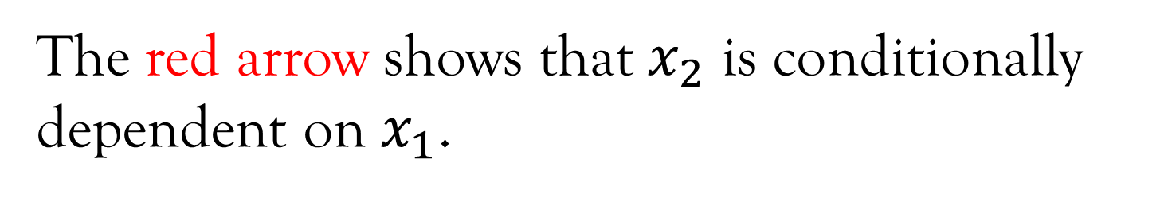
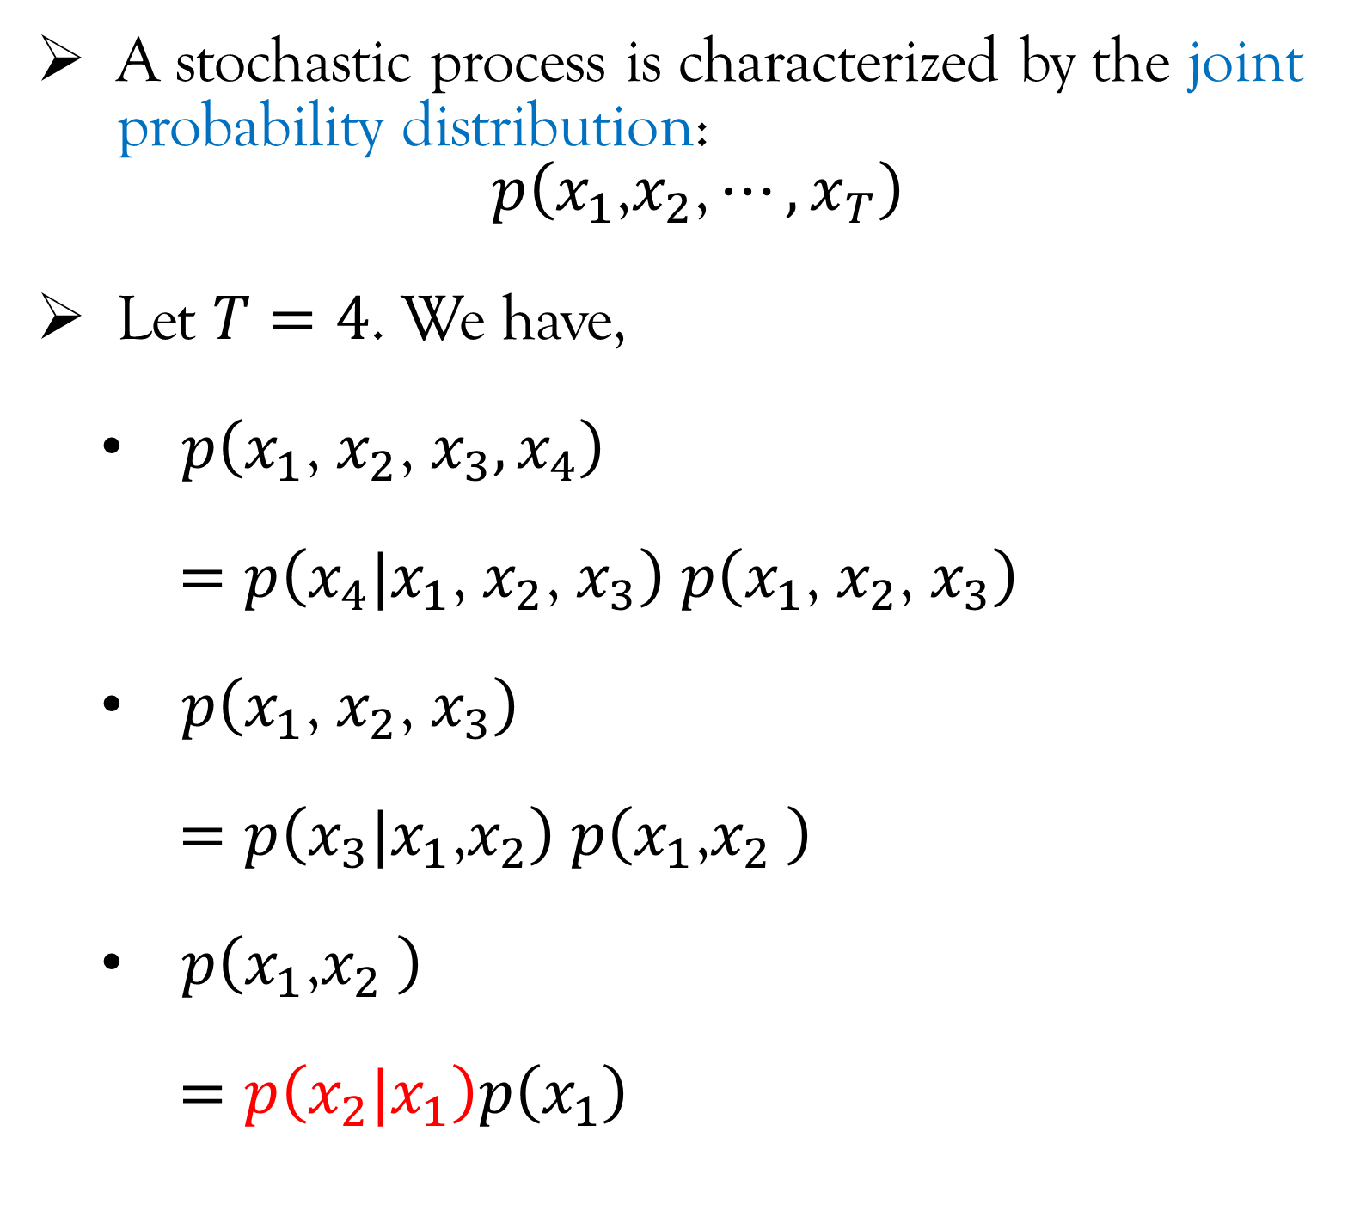
Stochastic Process
A stochastic process is characterized by the joint probability distribution:
$$p\left(x_{1}\text{,}x_{2}\text{,}⋯,x_{T}\right)$$
Let $T=4$. We have,
$p\left(x_{1}\text{,} x_{2}\text{,} x_{3}, x_{4}\right)$
$=p\left(x_{4}|x_{1}\text{, }x_{2}\text{, }x_{3}\right)$ $p\left(x_{1}\text{, }x_{2}\text{, }x_{3}\right)$
$p\left(x_{1}\text{, }x_{2}\text{, }x_{3}\right)$
$=p\left(x_{3}|x_{1}\text{,}x_{2}\right)$ $p\left(x_{1}\text{,}x_{2} \right)$
$p\left(x_{1}\text{,}x_{2} \right)$
$=p\left(x_{2}|x_{1}\right)p\left(x_{1}\right)$
Probabilistic Graphical Model (PGM)
PGMs are graphical representation of the conditional distribution function.
The arrows in the PGM represents the conditional distribution.
$$x_{1}$$
$$x_{2}$$
$$x_{3}$$
$$x_{4}$$
The red arrow shows that $x_{2}$ is conditionally dependent on $x_{1}$.

Slide 11
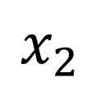
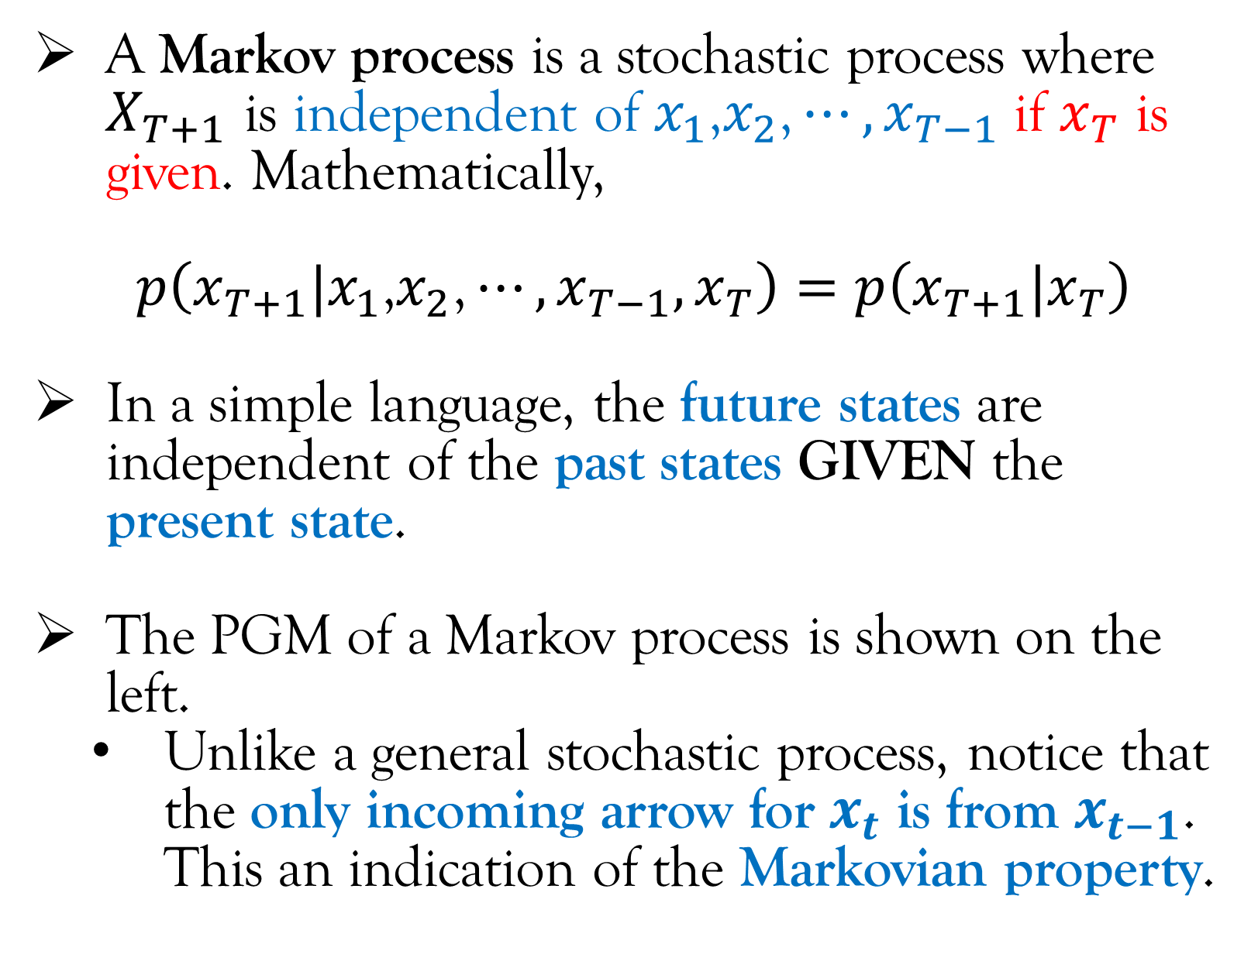
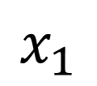
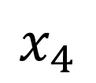
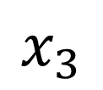
Stochastic Process
A Markov process is a stochastic process where $X_{T+1}$ is independent of $x_{1}\text{,}x_{2}\text{,}⋯,x_{T−1}$ if $x_{T}$ is given. Mathematically,
$$p\left(x_{T+1}|x_{1}\text{,}x_{2}\text{,}⋯,x_{T−1},x_{T}\right)=p\left(x_{T+1}|x_{T}\right)$$
In a simple language, the future states are independent of the past states GIVEN the present state.
The PGM of a Markov process is shown on the left.
Unlike a general stochastic process, notice that the only incoming arrow for $x_{t}$ is from $x_{t−1}$. This an indication of the Markovian property.
$$x_{1}$$
$$x_{2}$$
$$x_{3}$$
$$x_{4}$$

Slide 12
Lecture Content
Stochastic process (very brief introduction; only that what is required for this course).
Markov Decision Process and Reinforcement Learning.
Components of an MDP.
Policies.
Markov Decision Process vs Reinforcement Learning.
Special Cases of Markov Decision Process.
Stationary vs Non-Stationary Process.
Objective functions in Reinforcement Learning.
Reinforcement Learning vs ….

Slide 13
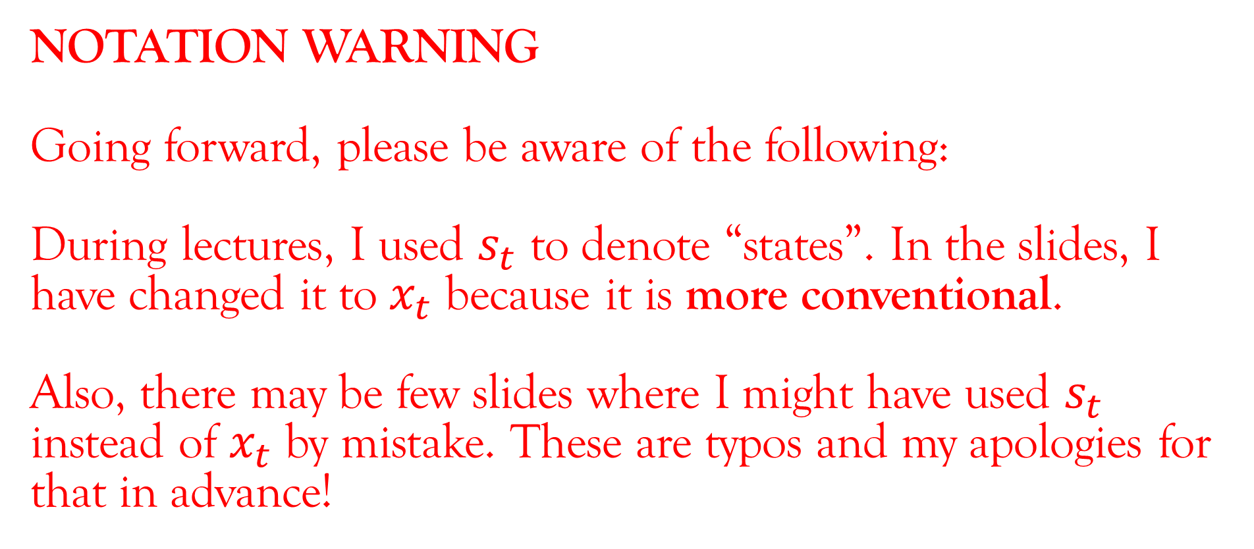
NOTATION WARNING
Going forward, please be aware of the following:
During lectures, I used $s_{t}$ to denote “states”. In the slides, I have changed it to $x_{t}$ because it is more conventional.
Also, there may be few slides where I might have used $s_{t}$ instead of $x_{t}$ by mistake. These are typos and my apologies for that in advance!

Slide 14
Markov Decision Process and Reinforcement Learning
A Markov Decision Process (MDP) is an extension of Markov process with two main differences:
Actions: There is an agent who has to take actions (decisions). Unlike Markov process where the next state is dependent only on the current state, in a MDP, the next state is dependent on the current state and the current action.
Rewards: The agent earns a reward based on its actions and the objective is to maximize the reward (in some sense).

Slide 15
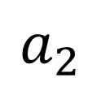
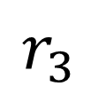
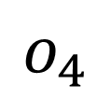
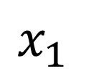
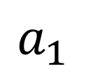
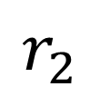
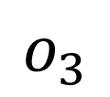
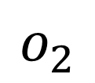
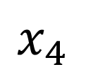
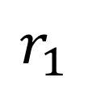
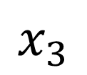
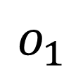
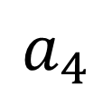
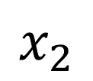
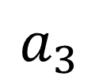
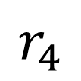
Markov Decision Process and Reinforcement Learning
The PGM of a Markov Decision Process* (MDP) is shown in the left.
An MDP* has the following components:
States: It captures the dynamics of the physical world that are relevant for making decisions.
The importance of the phrase highlighted in blue can be explained using the following example. As such, the moon is imparting some force on a car on road. But since it is so negligible, we can ignore it. Hence, we don’t need to capture the dynamics of the moon in order to design autonomous cars ☺!
Knowing what the states are requires domain knowledge.
*Strictly speaking, a Partially Observable MDP (POMDP). The difference between MDP and POMDP is explained after a few slides.
$$r_{1}$$
$$r_{2}$$
$$r_{3}$$
$$r_{4}$$
$$a_{1}$$
$$a_{2}$$
$$a_{3}$$
$$a_{4}$$
$$o_{1}$$
$$o_{2}$$
$$o_{3}$$
$$o_{4}$$
$$x_{1}$$
$$x_{2}$$
$$x_{3}$$
$$x_{4}$$
Time

Slide 16
Markov Decision Process and Reinforcement Learning
The PGM of a Markov Decision Process* (MDP) is shown in the left.
An MDP* has the following components:
Observations: Basically, whatever an agent observes in order to make decisions. The agent can only observe certain components of the states because of various limitations, e.g. In autonomous cars, we may only have the knowledge of the positions of the other vehicles and NOT their velocities because of sensor limitations.
Sometimes, because lack of domain knowledge, the agent may not observe a state because it does not know that it is relevant for decision making.
*Strictly speaking, a Partially Observable MDP (POMDP). The difference between MDP and POMDP is explained after a few slides.
$$r_{1}$$
$$r_{2}$$
$$r_{3}$$
$$r_{4}$$
$$a_{1}$$
$$a_{2}$$
$$a_{3}$$
$$a_{4}$$
$$o_{1}$$
$$o_{2}$$
$$o_{3}$$
$$o_{4}$$
$$x_{1}$$
$$x_{2}$$
$$x_{3}$$
$$x_{4}$$
Time

Slide 17
Markov Decision Process and Reinforcement Learning
The PGM of a Markov Decision Process* (MDP) is shown in the left.
An MDP* has the following components:
Actions: Basically, the action taken by the agent.
Rewards: Basically, the rewards received by the agent after taking an action.
*Strictly speaking, a Partially Observable MDP (POMDP). The difference between MDP and POMDP is explained after a few slides.
$$r_{1}$$
$$r_{2}$$
$$r_{3}$$
$$r_{4}$$
$$a_{1}$$
$$a_{2}$$
$$a_{3}$$
$$a_{4}$$
$$o_{1}$$
$$o_{2}$$
$$o_{3}$$
$$o_{4}$$
$$x_{1}$$
$$x_{2}$$
$$x_{3}$$
$$x_{4}$$
Time

Slide 18
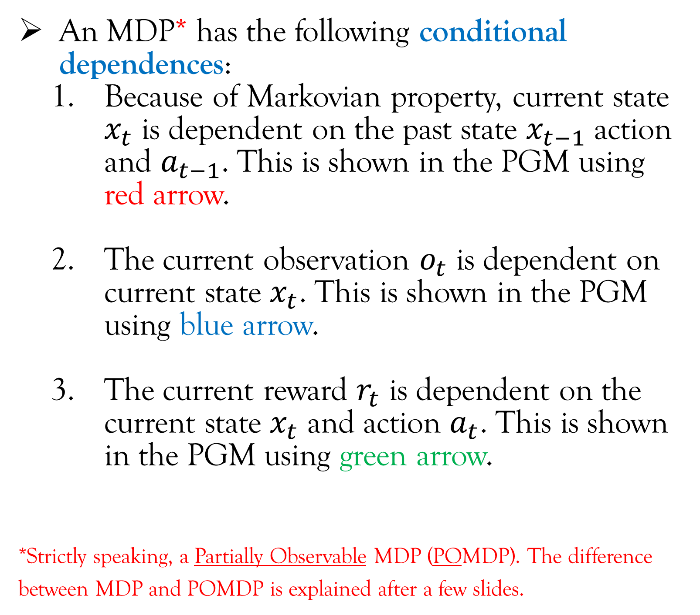
Markov Decision Process and Reinforcement Learning
An MDP* has the following conditional dependences:
Because of Markovian property, current state $x_{t}$ is dependent on the past state $x_{t−1}$ action and $a_{t−1}$. This is shown in the PGM using red arrow.
The current observation $o_{t}$ is dependent on current state $x_{t}$. This is shown in the PGM using blue arrow.
The current reward $r_{t}$ is dependent on the current state $x_{t}$ and action $a_{t}$. This is shown in the PGM using green arrow.
*Strictly speaking, a Partially Observable MDP (POMDP). The difference between MDP and POMDP is explained after a few slides.
$$r_{1}$$
$$r_{2}$$
$$r_{3}$$
$$r_{4}$$
$$a_{1}$$
$$a_{2}$$
$$a_{3}$$
$$a_{4}$$
$$o_{1}$$
$$o_{2}$$
$$o_{3}$$
$$o_{4}$$
$$x_{1}$$
$$x_{2}$$
$$x_{3}$$
$$x_{4}$$
Time

Slide 19
Markov Decision Process and Reinforcement Learning
Notice the red arrows in the PGM that shows that current action decides future states and hence the future rewards.
Because of the presence of these red arrows that taking greedy action to maximize the current reward is not a optimal decision. A greedy action may lead to a future state where rewards are low.
$$r_{1}$$
$$r_{2}$$
$$r_{3}$$
$$r_{4}$$
$$a_{1}$$
$$a_{2}$$
$$a_{3}$$
$$a_{4}$$
$$o_{1}$$
$$o_{2}$$
$$o_{3}$$
$$o_{4}$$
$$x_{1}$$
$$x_{2}$$
$$x_{3}$$
$$x_{4}$$
Time

Slide 20
Markov Decision Process and Reinforcement Learning
Policies
Question: Based on what does the agent decides its actions?
Answer: The agent decides its action based on a policy. Depending on the situation, there are two possible cases when it comes to designing policies.
(PTO)
$$r_{1}$$
$$r_{2}$$
$$r_{3}$$
$$r_{4}$$
$$a_{1}$$
$$a_{2}$$
$$a_{3}$$
$$a_{4}$$
$$o_{1}$$
$$o_{2}$$
$$o_{3}$$
$$o_{4}$$
$$x_{1}$$
$$x_{2}$$
$$x_{3}$$
$$x_{4}$$
Time

Slide 21
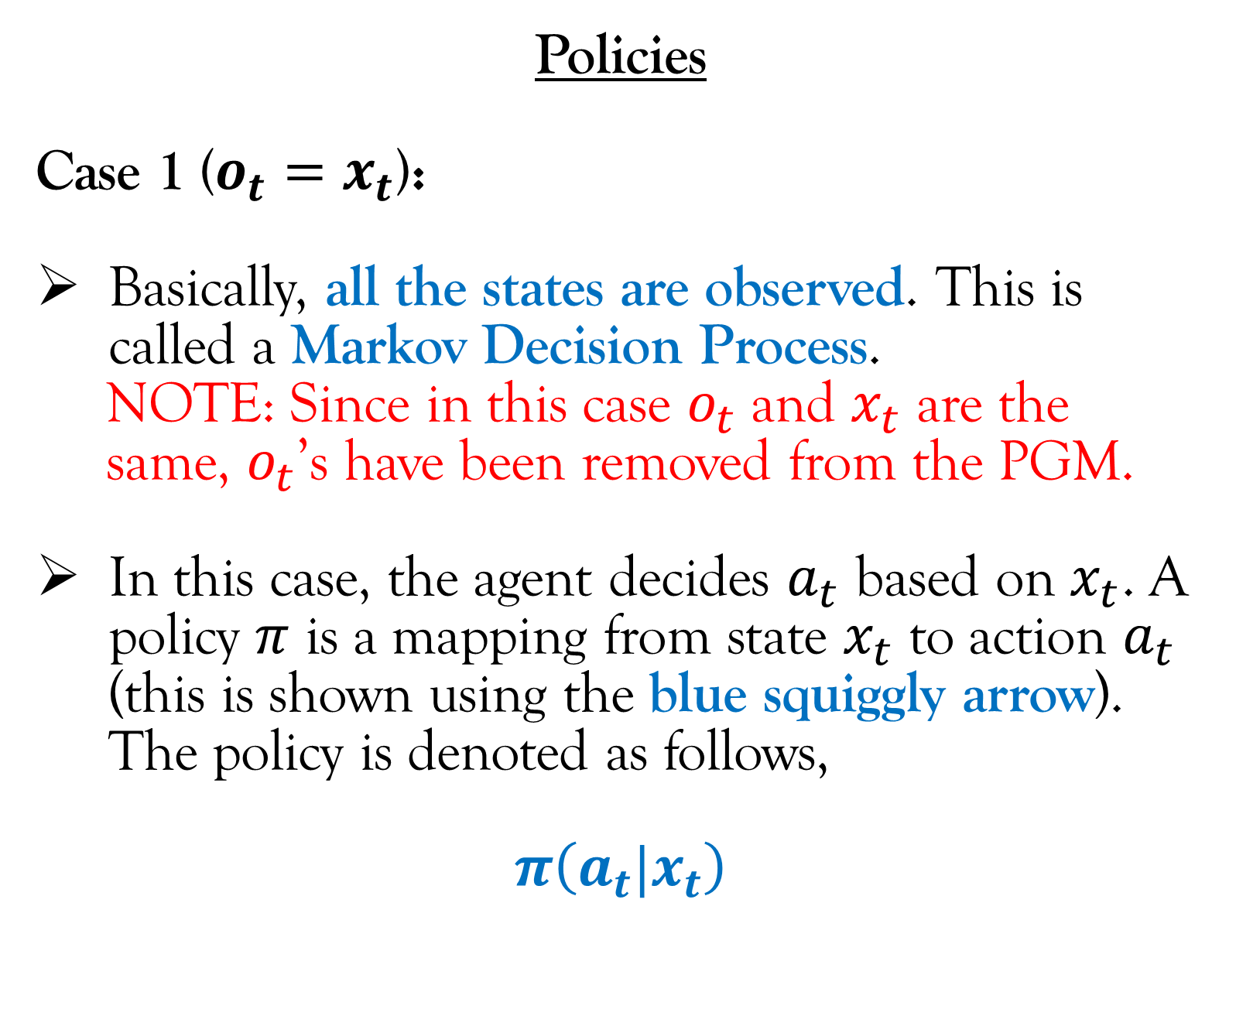
Markov Decision Process and Reinforcement Learning
Policies
Case 1 ($o_{t}=x_{t}$):
Basically, all the states are observed. This is called a Markov Decision Process.
NOTE: Since in this case $o_{t}$ and $x_{t}$ are the
same, $o_{t}$’s have been removed from the PGM.
In this case, the agent decides $a_{t}$ based on $x_{t}$. A policy $π$ is a mapping from state $x_{t}$ to action $a_{t}$ (this is shown using the blue squiggly arrow). The policy is denoted as follows,
$$π\left(a_{t}|x_{t}\right)$$
$$r_{1}$$
$$r_{2}$$
$$r_{3}$$
$$r_{4}$$
$$a_{1}$$
$$a_{2}$$
$$a_{3}$$
$$a_{4}$$
$$x_{1}$$
$$x_{2}$$
$$x_{3}$$
$$x_{4}$$
Time

Slide 22
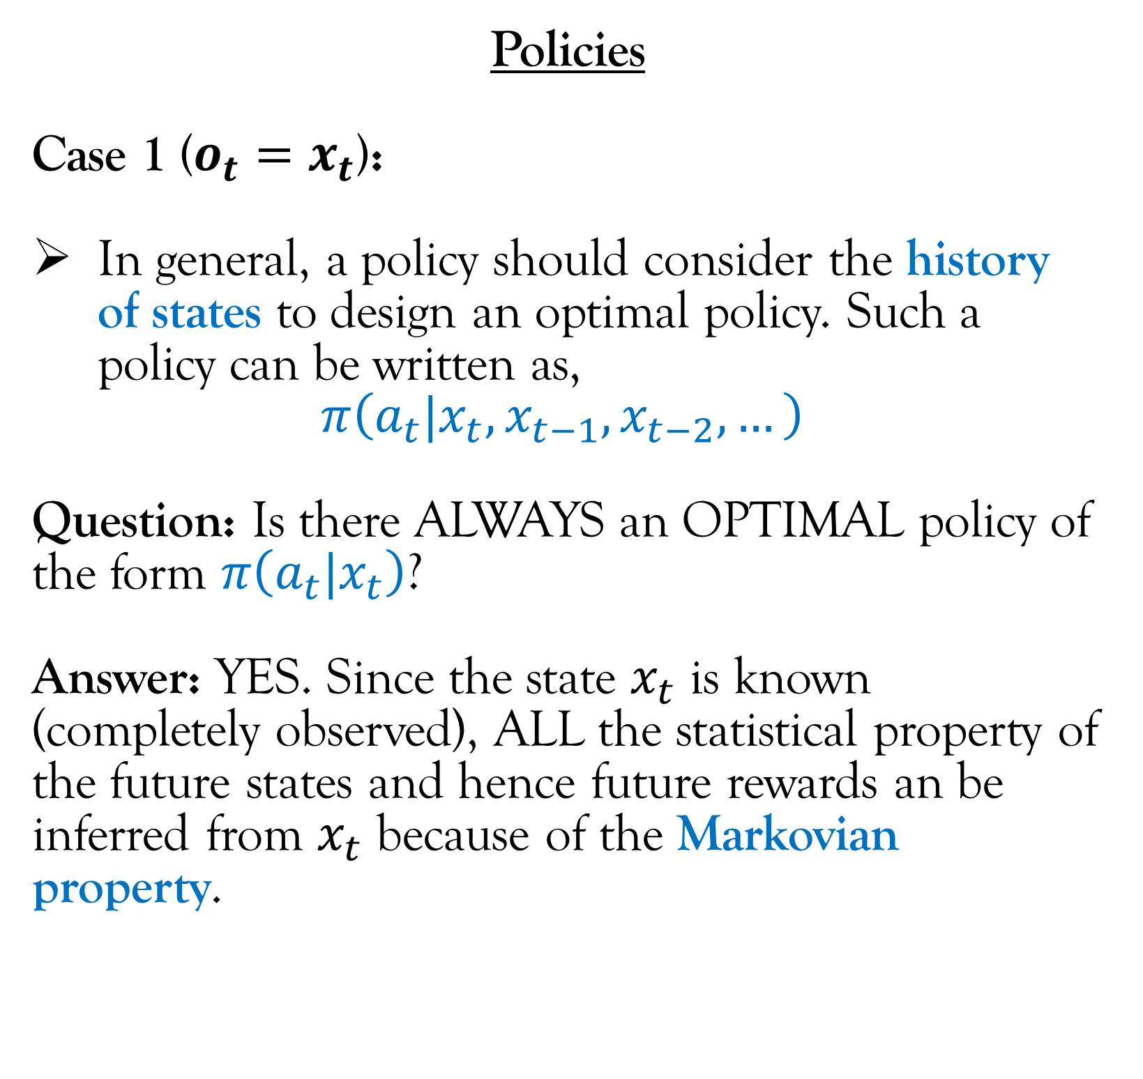
Markov Decision Process and Reinforcement Learning
Policies
Case 1 ($o_{t}=x_{t}$):
In general, a policy should consider the history of states to design an optimal policy. Such a policy can be written as,
$$π\left(a_{t}|x_{t},x_{t−1},x_{t−2},…\right)$$
Question: Is there ALWAYS an OPTIMAL policy of the form $π\left(a_{t}|x_{t}\right)$?
Answer: YES. Since the state $x_{t}$ is known (completely observed), ALL the statistical property of the future states and hence future rewards an be inferred from $x_{t}$ because of the Markovian property.
$$r_{1}$$
$$r_{2}$$
$$r_{3}$$
$$r_{4}$$
$$a_{1}$$
$$a_{2}$$
$$a_{3}$$
$$a_{4}$$
$$x_{1}$$
$$x_{2}$$
$$x_{3}$$
$$x_{4}$$
Time

Slide 23
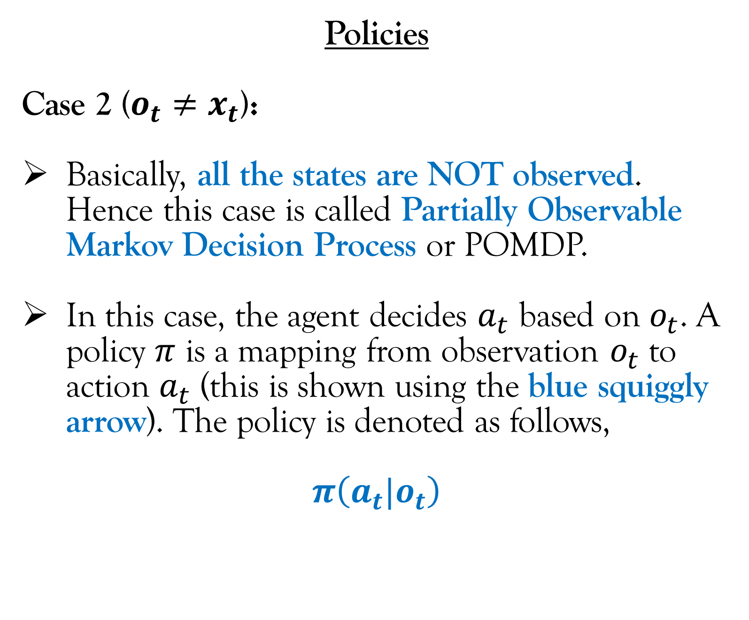
Markov Decision Process and Reinforcement Learning
Policies
Case 2 ($o_{t}≠x_{t}$):
Basically, all the states are NOT observed. Hence this case is called Partially Observable Markov Decision Process or POMDP.
In this case, the agent decides $a_{t}$ based on $o_{t}$. A policy $π$ is a mapping from observation $o_{t}$ to action $a_{t}$ (this is shown using the blue squiggly arrow). The policy is denoted as follows,
$$π\left(a_{t}|o_{t}\right)$$
$$r_{1}$$
$$r_{2}$$
$$r_{3}$$
$$r_{4}$$
$$a_{1}$$
$$a_{2}$$
$$a_{3}$$
$$a_{4}$$
$$o_{1}$$
$$o_{2}$$
$$o_{3}$$
$$o_{4}$$
$$x_{1}$$
$$x_{2}$$
$$x_{3}$$
$$x_{4}$$
Time

Slide 24
Markov Decision Process and Reinforcement Learning
Policies
Case 2 ($o_{t}≠x_{t}$):
Basically, all the states are NOT observed. Hence this case is called Partially Observable Markov Decision Process or POMDP.
In this case, the agent decides $a_{t}$ based on $o_{t}$. A policy $π$ is a mapping from observation $o_{t}$ to action $a_{t}$ (this is shown using the blue squiggly arrow). The policy is denoted as follows,
$$π\left(a_{t}|o_{t}\right)$$
$$r_{1}$$
$$r_{2}$$
$$r_{3}$$
$$r_{4}$$
$$a_{1}$$
$$a_{2}$$
$$a_{3}$$
$$a_{4}$$
$$o_{1}$$
$$o_{2}$$
$$o_{3}$$
$$o_{4}$$
$$x_{1}$$
$$x_{2}$$
$$x_{3}$$
$$x_{4}$$
Most of this course deals with MDP and NOT POMDP.
Time

Slide 25
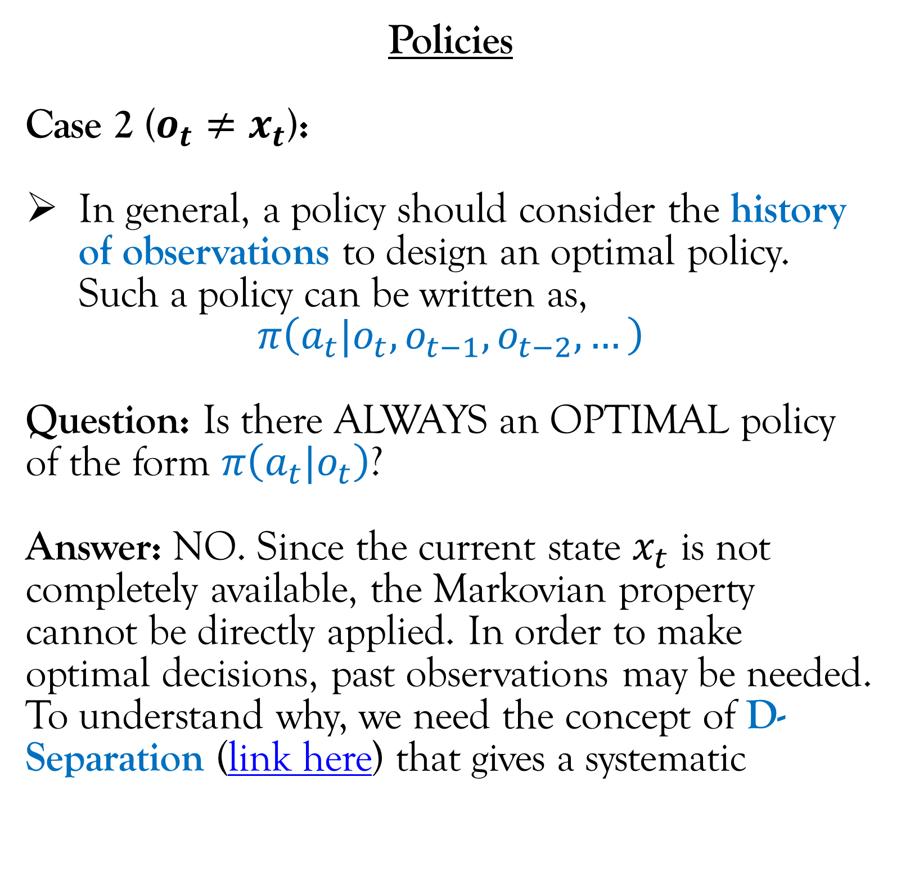
Markov Decision Process and Reinforcement Learning
Policies
Case 2 ($o_{t}≠x_{t}$):
In general, a policy should consider the history of observations to design an optimal policy. Such a policy can be written as,
$$π\left(a_{t}|o_{t},o_{t−1},o_{t−2},…\right)$$
Question: Is there ALWAYS an OPTIMAL policy of the form $π\left(a_{t}|o_{t}\right)$?
Answer: NO. Since the current state $x_{t}$ is not completely available, the Markovian property cannot be directly applied. In order to make optimal decisions, past observations may be needed. To understand why, we need the concept of D-Separation (link here) that gives a systematic
$$r_{1}$$
$$r_{2}$$
$$r_{3}$$
$$r_{4}$$
$$a_{1}$$
$$a_{2}$$
$$a_{3}$$
$$a_{4}$$
$$o_{1}$$
$$o_{2}$$
$$o_{3}$$
$$o_{4}$$
$$x_{1}$$
$$x_{2}$$
$$x_{3}$$
$$x_{4}$$
Time
(Continued on next slide)

Slide 26
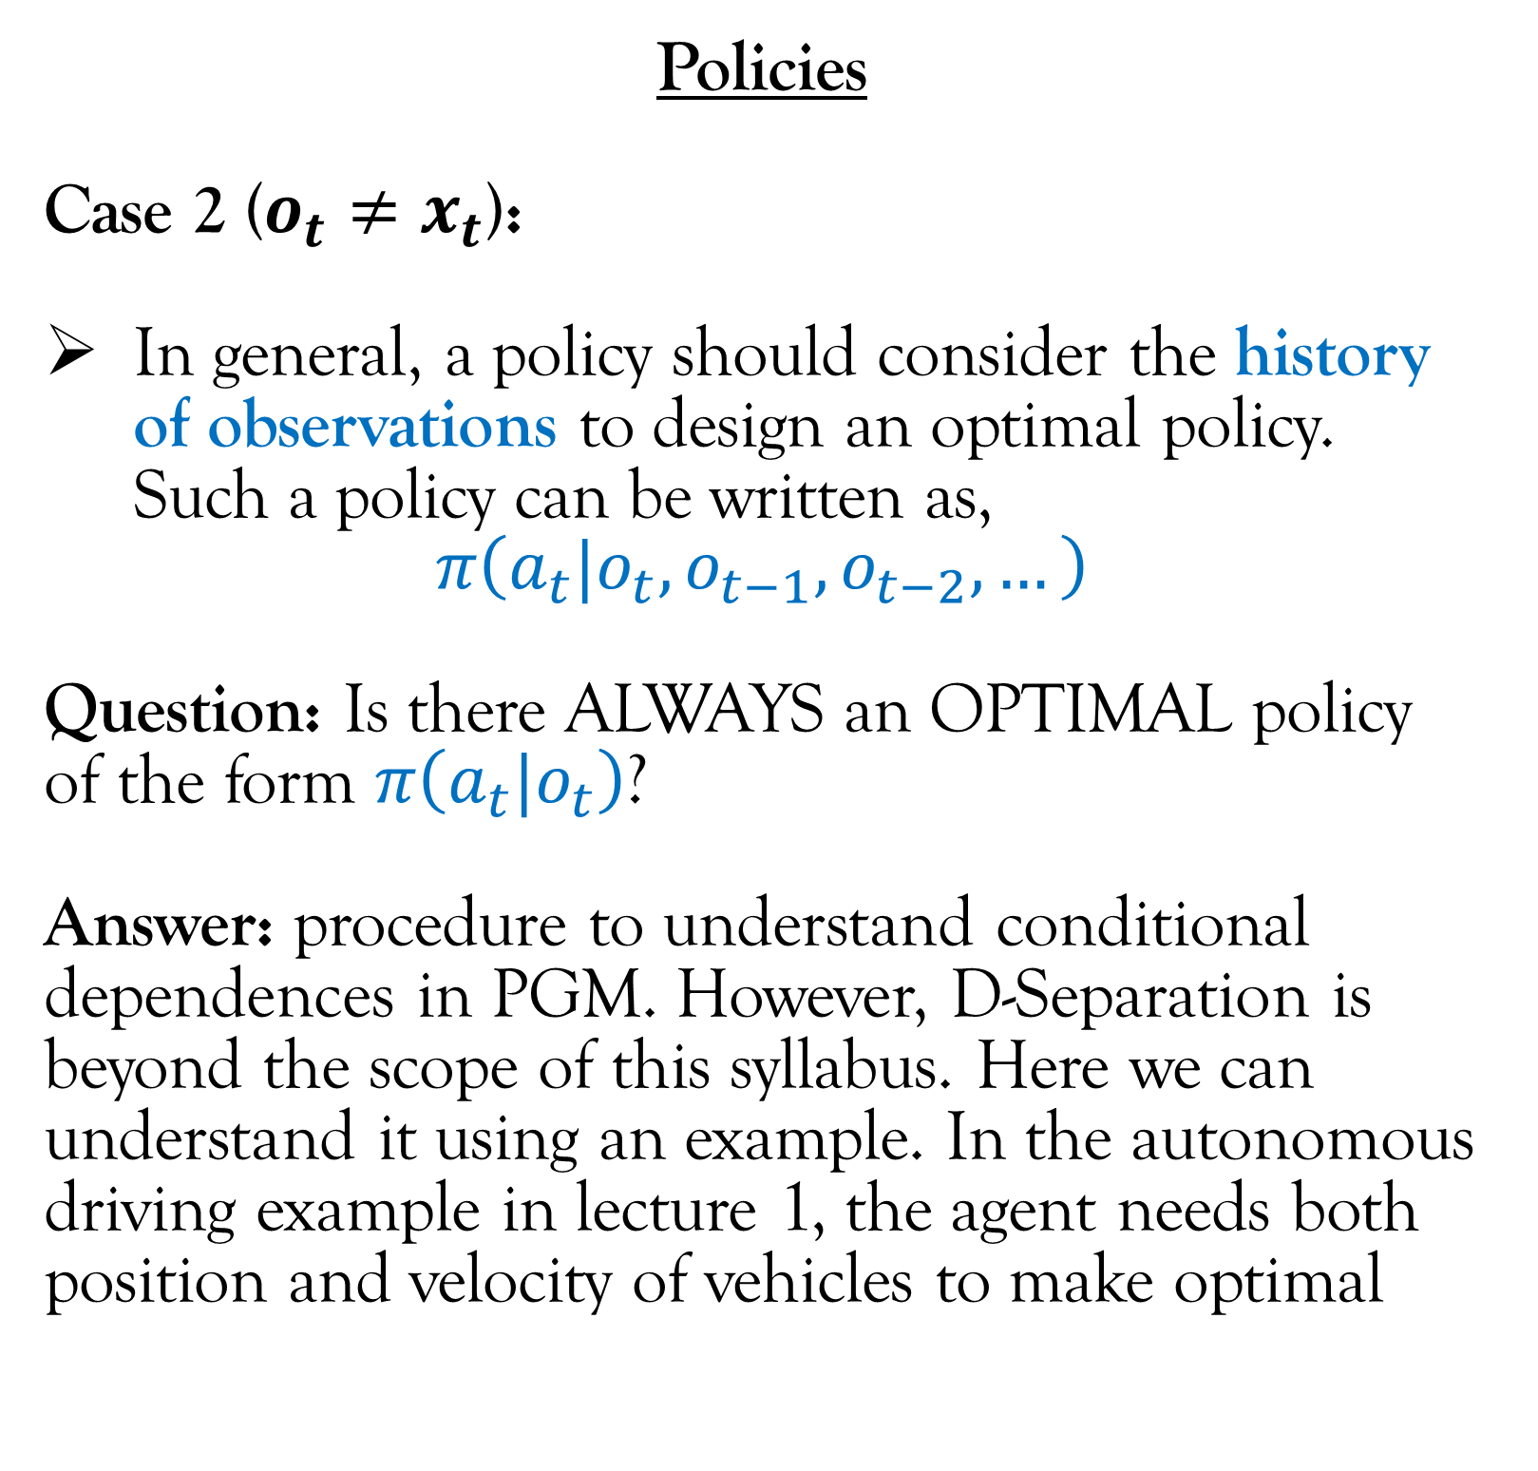
Markov Decision Process and Reinforcement Learning
Policies
Case 2 ($o_{t}≠x_{t}$):
In general, a policy should consider the history of observations to design an optimal policy. Such a policy can be written as,
$$π\left(a_{t}|o_{t},o_{t−1},o_{t−2},…\right)$$
Question: Is there ALWAYS an OPTIMAL policy of the form $π\left(a_{t}|o_{t}\right)$?
Answer: procedure to understand conditional dependences in PGM. However, D-Separation is beyond the scope of this syllabus. Here we can understand it using an example. In the autonomous driving example in lecture 1, the agent needs both position and velocity of vehicles to make optimal
$$r_{1}$$
$$r_{2}$$
$$r_{3}$$
$$r_{4}$$
$$a_{1}$$
$$a_{2}$$
$$a_{3}$$
$$a_{4}$$
$$o_{1}$$
$$o_{2}$$
$$o_{3}$$
$$o_{4}$$
$$x_{1}$$
$$x_{2}$$
$$x_{3}$$
$$x_{4}$$
Time
(Continued on next slide)

Slide 27
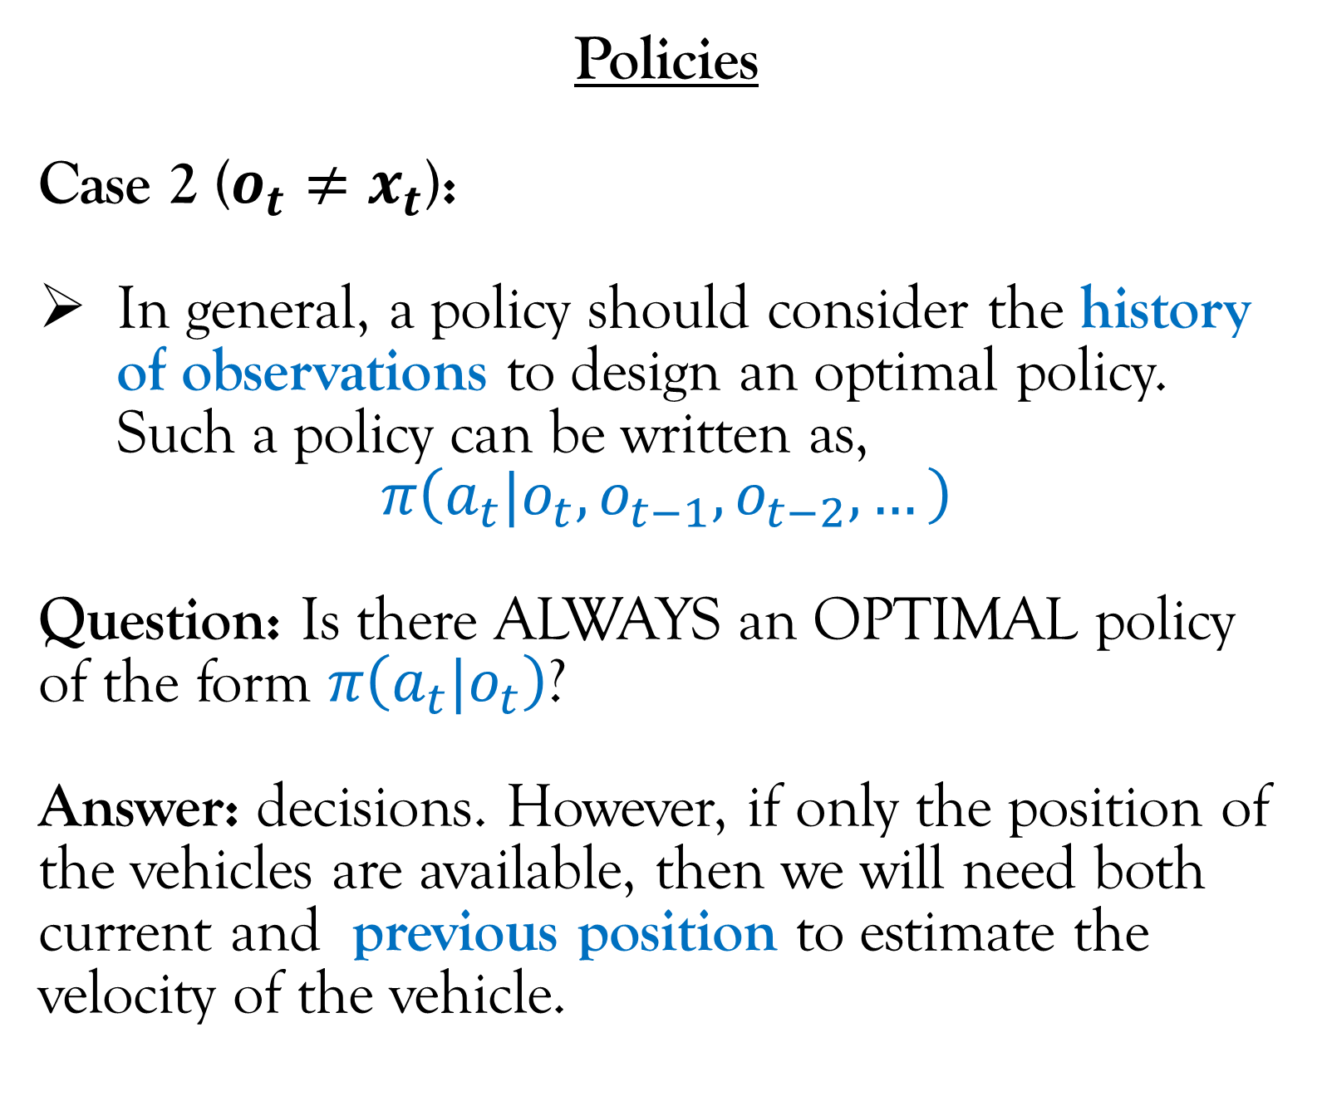
Markov Decision Process and Reinforcement Learning
Policies
Case 2 ($o_{t}≠x_{t}$):
In general, a policy should consider the history of observations to design an optimal policy. Such a policy can be written as,
$$π\left(a_{t}|o_{t},o_{t−1},o_{t−2},…\right)$$
Question: Is there ALWAYS an OPTIMAL policy of the form $π\left(a_{t}|o_{t}\right)$?
Answer: decisions. However, if only the position of the vehicles are available, then we will need both current and previous position to estimate the velocity of the vehicle.
$$r_{1}$$
$$r_{2}$$
$$r_{3}$$
$$r_{4}$$
$$a_{1}$$
$$a_{2}$$
$$a_{3}$$
$$a_{4}$$
$$o_{1}$$
$$o_{2}$$
$$o_{3}$$
$$o_{4}$$
$$x_{1}$$
$$x_{2}$$
$$x_{3}$$
$$x_{4}$$
Time
(Continued on next slide)

Slide 28
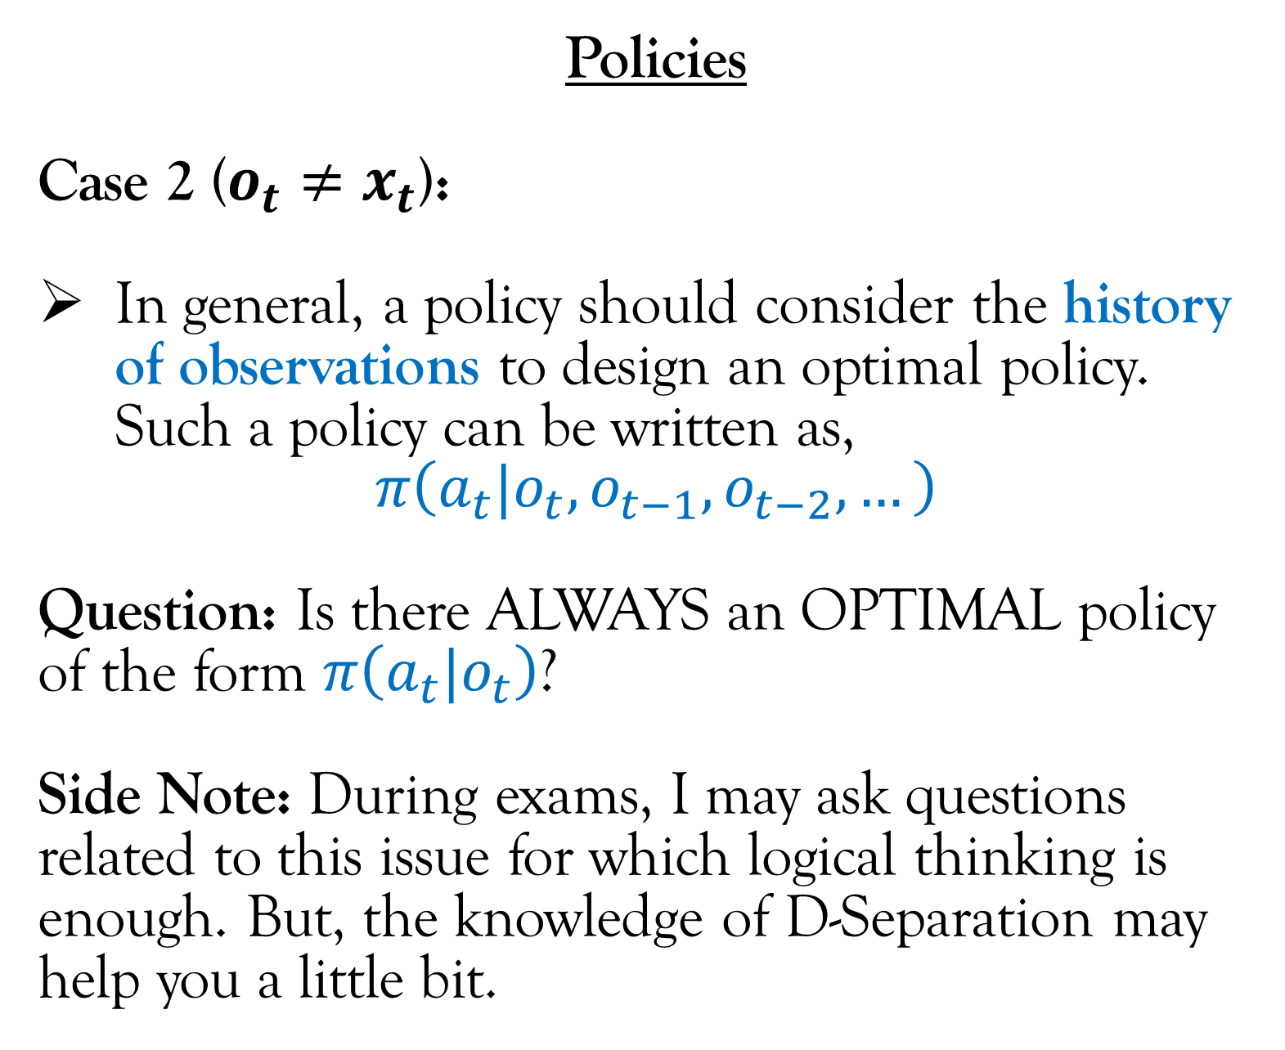
Markov Decision Process and Reinforcement Learning
Policies
Case 2 ($o_{t}≠x_{t}$):
In general, a policy should consider the history of observations to design an optimal policy. Such a policy can be written as,
$$π\left(a_{t}|o_{t},o_{t−1},o_{t−2},…\right)$$
Question: Is there ALWAYS an OPTIMAL policy of the form $π\left(a_{t}|o_{t}\right)$?
Side Note: During exams, I may ask questions related to this issue for which logical thinking is enough. But, the knowledge of D-Separation may help you a little bit.
$$r_{1}$$
$$r_{2}$$
$$r_{3}$$
$$r_{4}$$
$$a_{1}$$
$$a_{2}$$
$$a_{3}$$
$$a_{4}$$
$$o_{1}$$
$$o_{2}$$
$$o_{3}$$
$$o_{4}$$
$$x_{1}$$
$$x_{2}$$
$$x_{3}$$
$$x_{4}$$
Time

Slide 29
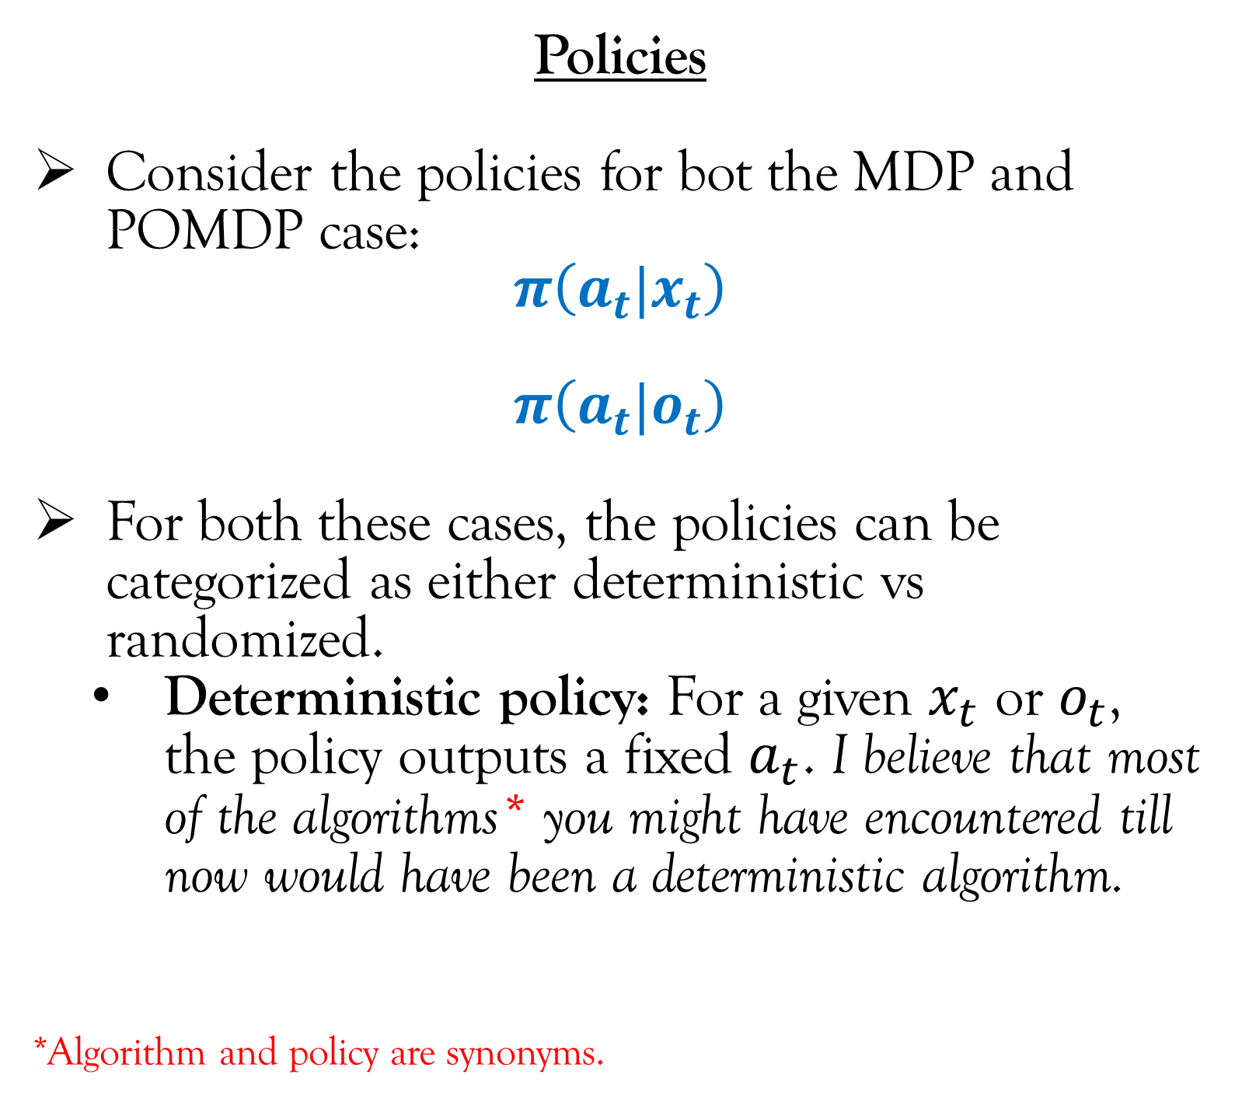
Markov Decision Process and Reinforcement Learning
Policies
Consider the policies for bot the MDP and POMDP case:
$$π\left(a_{t}|x_{t}\right)$$
$$π\left(a_{t}|o_{t}\right)$$
For both these cases, the policies can be categorized as either deterministic vs randomized.
Deterministic policy: For a given $x_{t}$ or $o_{t}$, the policy outputs a fixed $a_{t}$. I believe that most of the algorithms* you might have encountered till now would have been a deterministic algorithm.
*Algorithm and policy are synonyms.
$$r_{1}$$
$$r_{2}$$
$$r_{3}$$
$$r_{4}$$
$$a_{1}$$
$$a_{2}$$
$$a_{3}$$
$$a_{4}$$
$$o_{1}$$
$$o_{2}$$
$$o_{3}$$
$$o_{4}$$
$$x_{1}$$
$$x_{2}$$
$$x_{3}$$
$$x_{4}$$
Time

Slide 30
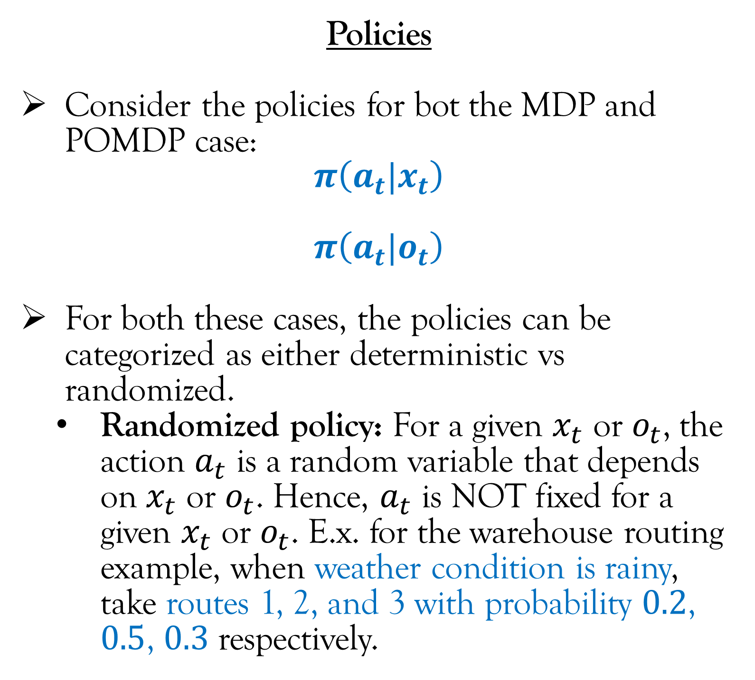
Markov Decision Process and Reinforcement Learning
Policies
Consider the policies for bot the MDP and POMDP case:
$$π\left(a_{t}|x_{t}\right)$$
$$π\left(a_{t}|o_{t}\right)$$
For both these cases, the policies can be categorized as either deterministic vs randomized.
Randomized policy: For a given $x_{t}$ or $o_{t}$, the action $a_{t}$ is a random variable that depends on $x_{t}$ or $o_{t}$. Hence, $a_{t}$ is NOT fixed for a given $x_{t}$ or $o_{t}$. E.x. for the warehouse routing example, when weather condition is rainy, take routes 1, 2, and 3 with probability $0.2$, $0.5$, $0.3$ respectively.
$$r_{1}$$
$$r_{2}$$
$$r_{3}$$
$$r_{4}$$
$$a_{1}$$
$$a_{2}$$
$$a_{3}$$
$$a_{4}$$
$$o_{1}$$
$$o_{2}$$
$$o_{3}$$
$$o_{4}$$
$$x_{1}$$
$$x_{2}$$
$$x_{3}$$
$$x_{4}$$
Time

Slide 31
Markov Decision Process and Reinforcement Learning
MDP (POMDP) vs Reinforcement Learning
Recall that the arrows in the PGM represents conditional distribution. These conditional distributions is basically the probabilistic model of the uncertainties associated with the system. Based on whether the conditional distribution is know or not, we have the following situations:
If the conditional distributions are known, we are interested in solving a “planning problem” where the objective is to maximize the reward. This is called an Markov Decision Process (MDP). This is dealt in Module 2 (1st half).
$$r_{1}$$
$$r_{2}$$
$$r_{3}$$
$$r_{4}$$
$$a_{1}$$
$$a_{2}$$
$$a_{3}$$
$$a_{4}$$
$$o_{1}$$
$$o_{2}$$
$$o_{3}$$
$$o_{4}$$
$$x_{1}$$
$$x_{2}$$
$$x_{3}$$
$$x_{4}$$
Time

Slide 32
Markov Decision Process and Reinforcement Learning
MDP (POMDP) vs Reinforcement Learning
Recall that the arrows in the PGM represents conditional distribution. These conditional distributions is basically the probabilistic model of the uncertainties associated with the system. Based on whether the conditional distribution is know or not, we have the following situations:
If the conditional distributions are NOT known, we are interested in solving a “planning + learning problem” where the objective is to maximize the reward which in turn needs the agent to learn the conditional distributions (either directly or indirectly). This is called Reinforcement Learning. This is dealt in Module 2 (2nd half), Module 3, and Module 4.
$$r_{1}$$
$$r_{2}$$
$$r_{3}$$
$$r_{4}$$
$$a_{1}$$
$$a_{2}$$
$$a_{3}$$
$$a_{4}$$
$$o_{1}$$
$$o_{2}$$
$$o_{3}$$
$$o_{4}$$
$$x_{1}$$
$$x_{2}$$
$$x_{3}$$
$$x_{4}$$
Time

Slide 33
Lecture Content
Stochastic process (very brief introduction; only that what is required for this course).
Markov Decision Process and Reinforcement Learning.
Special Cases of Markov Decision Process.
Contextual Bandits.
Multi-Armed Bandits.
Stationary vs Non-Stationary Process.
Objective functions in Reinforcement Learning.
Reinforcement Learning vs ….

Slide 34
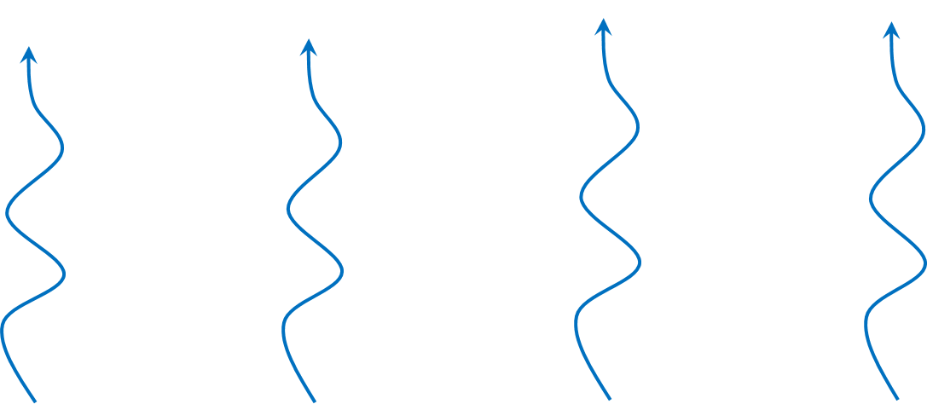
Special Cases of Markov Decision Process
The PGM of a MDP is shown in the left.
$$r_{1}$$
$$r_{2}$$
$$r_{3}$$
$$r_{4}$$
$$a_{1}$$
$$a_{2}$$
$$a_{3}$$
$$a_{4}$$
$$x_{1}$$
$$x_{2}$$
$$x_{3}$$
$$x_{4}$$
Time

Slide 35
Special Cases of Markov Decision Process
A contextual bandit is a special case of MDP where there is no temporal dependence (dependence over time) between current states and actions to future state.
Since, there is no temporal dependence, we can make greedy decisions in every time step and yet come up with an optimal policy.
The states are called “context”.
We will learn about contextual bandits in Module 1.
$$r_{1}$$
$$r_{2}$$
$$r_{3}$$
$$r_{4}$$
$$a_{1}$$
$$a_{2}$$
$$a_{3}$$
$$a_{4}$$
$$x_{1}$$
$$x_{2}$$
$$x_{3}$$
$$x_{4}$$
Time

Slide 36
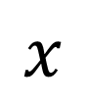



Special Cases of Markov Decision Process
A multi-armed bandit is special case of contextual bandit where there is only one state and hence the state does not change with time.
$$r_{1}$$
$$r_{2}$$
$$r_{3}$$
$$r_{4}$$
$$a_{1}$$
$$a_{2}$$
$$a_{3}$$
$$a_{4}$$
$$x$$
$$x$$
$$x$$
$$x$$
Time

Slide 37

Special Cases of Markov Decision Process
A multi-armed bandit (MAB) is special case of contextual bandit where there is only one state and hence the state does not change with time.
Since there is only one state $x$, we can ignore the state.
This is similar to supervised learning. If there is a feature (a column) that has same entry for all the rows, we can drop that feature.
So, in essence the reward only depends on the action.
We will learn about multi-armed bandits in Module 1.
$$r_{1}$$
$$r_{2}$$
$$r_{3}$$
$$r_{4}$$
$$a_{1}$$
$$a_{2}$$
$$a_{3}$$
$$a_{4}$$
Time

Slide 38
Special Cases of Markov Decision Process
For MAB, if we know the expected reward for all the actions, we would always select the action with the maximum expected reward.
Similarly for contextual bandits, if we know the expected reward for all the actions of a given state, we would always select the action with the maximum expected reward for that given state.
Hence, the planning problem* for both MAB and contextual bandits is TRIVIAL!
Important: The phase multi-armed bandit (or MAB) and contextual bandit by default means learning + planning problem. , i.e. the probabilistic model of the system is not known.
*Recall that planning problem is the case when we know the probabilistic model of the system.
$$r_{1}$$
$$r_{2}$$
$$r_{3}$$
$$r_{4}$$
$$a_{1}$$
$$a_{2}$$
$$a_{3}$$
$$a_{4}$$
Time

Slide 39
Special Cases of Markov Decision Process
For MAB, if we know the expected reward for all the actions, we would always select the action with the maximum expected reward.
Similarly for contextual bandits, if we know the expected reward for all the actions of a given state, we would always select the action with the maximum expected reward for that given state.
Hence, the planning problem* for both MAB and contextual bandits is TRIVIAL!
Important: The phase multi-armed bandit (or MAB) and contextual bandit by default means learning + planning problem. , i.e. the probabilistic model of the system is not known.
*Recall that planning problem is the case when we know the probabilistic model of the system.
$$r_{1}$$
$$r_{2}$$
$$r_{3}$$
$$r_{4}$$
$$a_{1}$$
$$a_{2}$$
$$a_{3}$$
$$a_{4}$$
Time

Slide 40

Special Cases of Markov Decision Process
A Conceptual Dilemma about Bandits
For MAB and contextual bandit, does the current action decides future reward?
$$r_{1}$$
$$r_{2}$$
$$r_{3}$$
$$r_{4}$$
$$a_{1}$$
$$a_{2}$$
$$a_{3}$$
$$a_{4}$$
Time

Slide 41
Special Cases of Markov Decision Process
A Conceptual Dilemma about Bandits
For MAB and contextual bandit, does the current action decides future reward?
This question leads to the following dilemma:
In MAB and contextual bandits there is no temporal dependence (as it is clear from the PGM on the left). So, it seems that the current action should not decide future rewards.
However, consider the warehouse routing example. If we travel a route that we didn’t travel before and had a good experience, we are likely to travel that route in the future. This shows that current actions (traveling a route) definitely decides the future actions and hence the future rewards (travel time in future).
$$r_{1}$$
$$r_{2}$$
$$r_{3}$$
$$r_{4}$$
$$a_{1}$$
$$a_{2}$$
$$a_{3}$$
$$a_{4}$$
The dilemma
Time

Slide 42





Special Cases of Markov Decision Process
A Conceptual Dilemma about Bandits
This contradiction arises because the PGM in the previous slide has to be modified for the planning + learning scenario.
In the planning + learning scenario, the “experience” is used to update the agents estimate of the probabilistic model of the system. Let $Γ_{t}$ denote the estimate of the probabilistic model at time $t$.
$Γ_{t+1}$ (updated model), is dependent on $Γ_{t}$ (current model), $a_{t}$ (the current action that the agent takes), and $r_{t}$ (the current experience).
The action at time $t$ is dependent on the estimate of the probabilistic model at time $t$ (blue arrow).
$$r_{1}$$
$$r_{2}$$
$$r_{3}$$
$$r_{4}$$
$$a_{1}$$
$$a_{2}$$
$$a_{3}$$
$$a_{4}$$
$$Γ_{1}$$
$$Γ_{2}$$
$$Γ_{3}$$
$$Γ_{4}$$
Time

Slide 43
Special Cases of Markov Decision Process
A Conceptual Dilemma about Bandits
As it can be clearly seen from the PGM, there is clearly a temporal dependence for MAB and contextual bandits. Hence, the current action does decide future reward.
$$r_{1}$$
$$r_{2}$$
$$r_{3}$$
$$r_{4}$$
$$a_{1}$$
$$a_{2}$$
$$a_{3}$$
$$a_{4}$$
$$Γ_{1}$$
$$Γ_{2}$$
$$Γ_{3}$$
$$Γ_{4}$$
$$R_{discounted}=r_{0}+βr_{1}+β^{2}r_{2}+β^{3}r_{3}+…$$
Time

Slide 44
Lecture Content
Stochastic process (very brief introduction; only that what is required for this course).
Markov Decision Process and Reinforcement Learning.
Special Cases of Markov Decision Process.
Stationary vs Non-Stationary Process.
Objective functions in Reinforcement Learning.
Reinforcement Learning vs ….

Slide 45















Stationary vs Non-Stationary Process
Mahindra
University
We will be dealing with stationary stochastic processes for like 95% of this course.
The actual definition of Stationary/Non-Stationary Stochastic process is quite involved and so I will only explain it with an example over here.
Consider the warehouse routing example which can be formulated as a MAB.
Let time step $t$ denote the $t^{th}$ hour of the day, e.x. from 10:00 am to 11:00 am.
The action at time step $t$ is $a_{t}∈\left\{R_{1},R_{2},R_{3}\right\}$.
NOTE: Routes $R_{1}$ and $R_{2}$ merges at one point
$$R_{1}$$
$$R_{2}$$
$$R_{3}$$
$$r_{1}$$
$$r_{2}$$
$$r_{3}$$
$$r_{4}$$
$$a_{1}$$
$$a_{2}$$
$$a_{3}$$
$$a_{4}$$

Slide 46

Stationary vs Non-Stationary Process
Mahindra
University
Let’s consider two different costs:
Fuel cost
For a given route, the fuel cost at different time of the day does NOT change much the hour of the day.
Let $θ_{t}$ denote the fuel cost at time $t$.
Let $F_{k}=P\left[θ_{t} | a_{t}=k\right]$ denote the probability density function of the fuel cost for route $k$.
Notice that probability density function $F_{k}$ is NOT dependent on $t$. This is because the statistical property of fuel cost does not change (much) with the hour of the day. Hence, a stationary process.
Important: Even though $F_{k}$ is NOT dependent on $t$, $θ_{t}$ that is sampled from $F_{k}$ (denoted by $θ_{t}\sim F_{k}$) DOES CHANGE with time.
NOTE: Routes $R_{1}$ and $R_{2}$ merges at one point
$$R_{1}$$
$$R_{2}$$
$$R_{3}$$
$$r_{1}$$
$$r_{2}$$
$$r_{3}$$
$$r_{4}$$
$$a_{1}$$
$$a_{2}$$
$$a_{3}$$
$$a_{4}$$

Slide 47

Stationary vs Non-Stationary Process
Mahindra
University
Let’s consider two different costs:
Travel time
For a given route, the travel time at different time of the day does change with the hour of the day.
Let $φ_{t}$ denote the travel time at time $t$.
Let $G_{k,t}=P\left[φ_{t} | a_{t}=k\right]$ denote the probability density function of the travel time for route $k$.
Notice that probability density function $G_{k,t}$ is dependent on $t$. This is because the statistical property of travel time does change with the hour of the day. Hence, a non-stationary process.
NOTE: Routes $R_{1}$ and $R_{2}$ merges at one point
$$R_{1}$$
$$R_{2}$$
$$R_{3}$$
$$r_{1}$$
$$r_{2}$$
$$r_{3}$$
$$r_{4}$$
$$a_{1}$$
$$a_{2}$$
$$a_{3}$$
$$a_{4}$$

Slide 48
Lecture Content
Stochastic process (very brief introduction; only that what is required for this course).
Markov Decision Process and Reinforcement Learning.
Special Cases of Markov Decision Process.
Stationary vs Non-Stationary Process.
Objective functions in Reinforcement Learning.
Reinforcement Learning vs ….

Slide 49

Objective functions in Reinforcement Learning
Since reinforcement learning (RL) is essentially an optimization problem, one of the first step is to decide the objective function. The following objective functions are widely used in RL.
Sum of rewards
$$R_{sum}=\sum_{t=0}^{T}{r_{t}}$$
Here $T$ is the time horizon and it is finite.

Slide 50

Objective functions in Reinforcement Learning
Since reinforcement learning (RL) is essentially an optimization problem, one of the first step is to decide the objective function. The following objective functions are widely used in RL.
Average reward
$$R_{avg}=\underset{T→∞}{lim inf}{\frac{1}{T+1}\sum_{t=0}^{T}{r_{t}}}$$
Here, the time horizon $T$ is infinite.

Slide 51

Objective functions in Reinforcement Learning
Since reinforcement learning (RL) is essentially an optimization problem, one of the first step is to decide the objective function. The following objective functions are widely used in RL.
Discounted reward
$$R_{discounted}=\sum_{t=0}^{∞}{β^{t}r_{t}}$$
where $β∈\left(0,1\right)$ is the discount factor.
Similar to average reward, the time horizon is infinite.
The expanded form of discounted reward is
$$R_{discounted}=r_{0}+βr_{1}+β^{2}r_{2}+β^{3}r_{3}+…$$
Since $β∈\left(0,1\right)$, the weight $β^{t}$ associated with reward decreases with time. In other words, for
a given time step, the reward in that time step is weighted more than reward in future time step.
This qualitatively means that reward today is better than reward tomorrow.

Slide 52

Objective functions in Reinforcement Learning
Since reinforcement learning (RL) is essentially an optimization problem, one of the first step is to decide the objective function. The following objective functions are widely used in RL.
Discounted reward
$$R_{discounted}=\sum_{t=0}^{∞}{β^{t}r_{t}}$$
where $β∈\left(0,1\right)$ is the discount factor.
In this course, we will be dealing only with discounted rewards and not average rewards because of three reasons.
Reason 1: The policy for average reward can be obtained from the policy for discounted
reward by simply letting $β→1$.
Reason 2: From mathematical perspective, it is much easier to deal with discounted reward
than average reward. Average reward has many “corner cases” that makes its analysis tedious.

Slide 53

Objective functions in Reinforcement Learning
Since reinforcement learning (RL) is essentially an optimization problem, one of the first step is to decide the objective function. The following objective functions are widely used in RL.
Discounted reward
$$R_{discounted}=\sum_{t=0}^{∞}{β^{t}r_{t}}$$
where $β∈\left(0,1\right)$ is the discount factor.
In this course, we will be dealing only with discounted rewards and not average rewards because of three reasons.
Reason 3: When the underlying stochastic process is non-stationary, discounted reward is
likely to generate better outcome then average reward. This is because when the statistical
property of the system is changing with time, it is a good idea to focus on the current reward
(and maybe rewards few steps ahead) and not planning for the rewards much ahead of the
current time step. Discounted reward achieves this by assigning more weightage to current
reward than future rewards (average reward assigns equal weightage to all rewards).

Slide 54

Thank you

